Slide 1
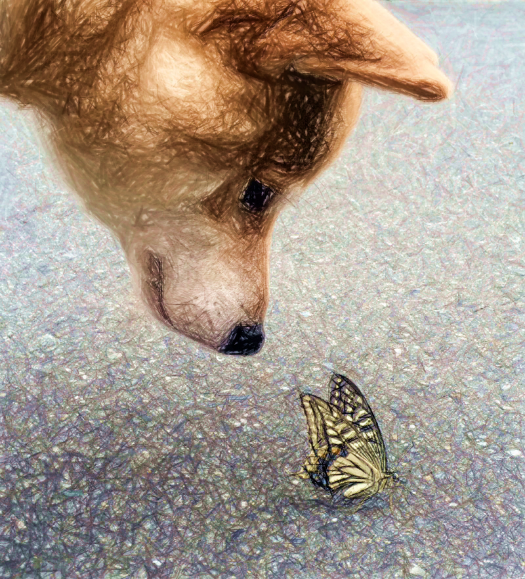
PONTA the SHIBA
Unhappy!
Happy!

